Slide 1


PRESENTATION OF FINAL RESULTS
Assessing the feasibility of SAF as a green market opportunity for oil palm in the Orinoquia
The World Bank – Ricardo
27/10/2023

Slide 2
AGENDA
Assessing Colombian oil palm derivatives as a feasible SAF feedstock
Analysis of aviation fuel demand, SAF blending scenarios and emissions reductions
Proposed pathway for developing a SAF industry in Colombia and final recommendations

Slide 3




Company overview
Objective and general scope
Assess the opportunities and challenges associated with promoting sustainable aviation fuels (SAF) produced from palm oil and oil palm residues as a green market opportunity for oil palm growers in the Orinoquía region of Colombia.
This study aimed to:
Assess the potential of oil palm derivates as a feedstock for SAF production.
Model the potential SAF production from Crude Palm Oil (CPO) and oil palm residues
Potential blending scenarios between SAF and conventional jet fuel in Colombia.
Capacity to meet a potential SAF demand with a nationally sourced feedstock
Modelling GHG emissions mitigation potential from using SAF produced from oil palm in Colombia.
Assess the impacts of implementing various public policy measures to accelerate SAF production.
Propose a pathway to promote the large-scale production and use of SAF in Colombia.
Provide specific recommendations to Government and value chain stakeholders to develop a SAF industry in Colombia
Providing advice to the World Bank on promoting opportunities for oil palm growers in the Orinoquía region.

Slide 4
AGENDA
Assessing Colombian oil palm derivatives as a feasible SAF feedstock
Analysis of aviation fuel demand, SAF blending scenarios and emissions reductions
Proposed pathway for developing a SAF industry in Colombia and final recommendations

Slide 5





SAF PRODUCTION POTENTIAL FROM PALM
Overview
The question: What role can palm derived SAF play in decarbonising the Colombian aviation sector?
Our approach:
Palm Production
SAF Production
SAF Uptake
Emissions Reduction
How much feedstock can the Colombian palm industry produce?
What are the prospects of SAF from palm derived feedstocks and what can policy do to stimulate production?
How much SAF are airlines in Colombia likely to demand, and which incentives could work?
What emissions reductions can be achieved using palm derived SAF?

Slide 6
SAF PRODUCTION POTENTIAL FROM PALM
Technical Requirements
SAF must be produced according to an International standard (ASTM D7566 – Standard Specification for Aviation Turbine Fuel Containing Synthesized Hydrocarbons)
Currently, only 8 fuel production pathways are allowed by this standard.
New SAFs can be added to ASTM D7566, but must undergo a comprehensive approval process (ASTM D4054 – Standard Practice for Evaluation of New Aviation Turbine Fuels and Fuel Additives)
The technical standards ensure that SAF is compatible with aircraft and ensure safe and reliable operation.
These standards do not mandate that the “SAF” is sustainable.
Production Technology | Feedstock | Blending Limit (% volume) Up to: | Relevance for palm-derived raw materials
Hydroprocessed esters and fatty acids (HEFA) | Lipids and fatty acids (e.g. used cooking oil, animal fat, or vegetable oil) | 50% | High (Palm oil)
Fischer-Tropsch synthesised paraffinic kerosene (FT-SPK) | Solid biomass (e.g. agricultural residues) | 50% | High (residues)
Power to liquids (PtL) synthesised paraffinic kerosene (PtL FT-SPK) | Renewable electricity | 50% | Low
Alcohol-to-jet synthesised paraffinic kerosene (ATJ-SPK) | Alcohol (typically ethanol, iso-butanol) | 50% | Low
Synthesised isoparaffins (SIP) | Sugars | 10% | Low
Catalytic hydrothermolysis jet (CHJ) | Lipids and fatty acids (e.g. used cooking oil, animal fat, or vegetable oil) | 50% | Medium
HEFA from algae | Micro-algae oils | 10% | Low
Direct sugars to hydrocarbons | Conventional sugars, lignocellulosic sugars | 10% | Medium

Slide 7
SAF PRODUCTION POTENTIAL FROM PALM
Potential for palm production in Colombia
We developed a model to estimate the regional potential for palm production in Colombia from 2022 - 2050.
The model estimates the production of crude palm oil (CPO) and palm residues (empty fruit bunches (EFB), fibres and shells).
Parameter: | Land Availability | Productivity | Availability for SAF production | Conversion to SAF
Description: | Total area of land available for palm cultivation for SAF and non-SAF uses. | Quantity of: CPO produced per ha harvested Residues produced per tonne of FFB harvested. | Quantity of CPO/residues produced that are available for SAF production, once competing use has been met. | The amount of SAF that can be produced from the available CPO/residues.
Key Assumptions: | Land area continues to expand at the 2012-2022 average rate. | CPO & FFB yield equals 2012-2022 average. Ratio of residues per tonne of FFB remains at current level. | Demand for CPO from traditional sectors remains constant. Only CPO produced with methane capture is available for SAF production. 100% of CPO is produced with methane capture by 2030. The proportion of residues produced that are utilised by mills remains constant. | CPO is assumed to be converted by the HEFA-SPK process. Residues are assumed to be converted by the FT-SPK process.

Slide 8
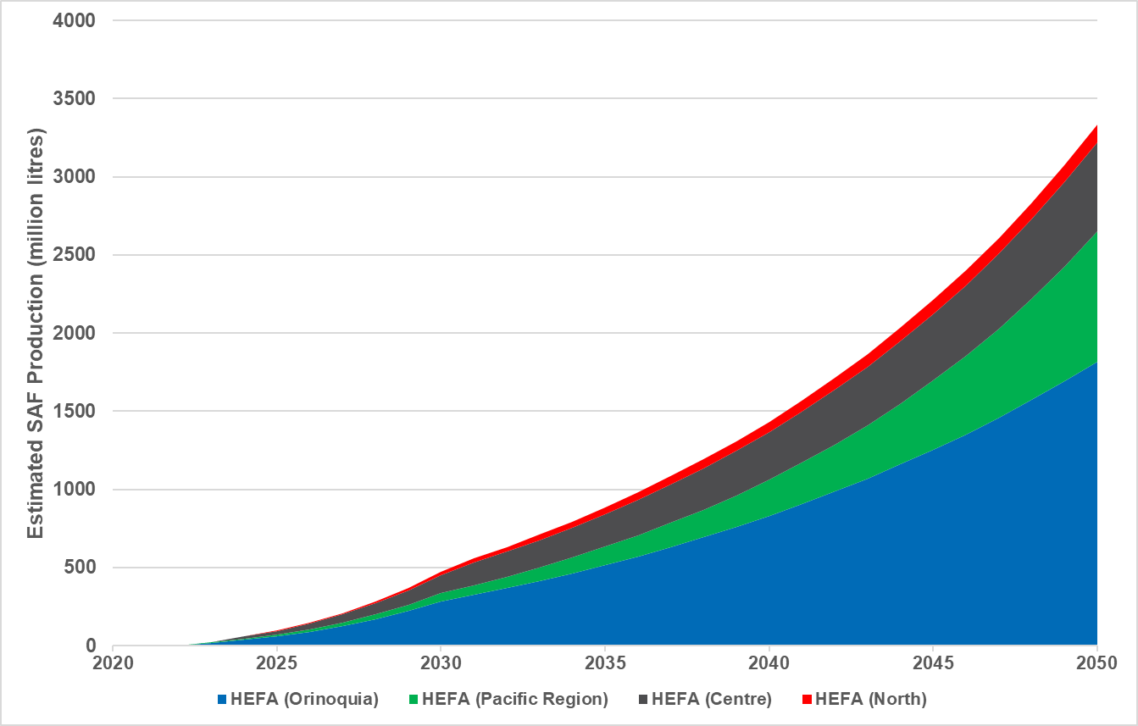
SAF PRODUCTION POTENTIAL FROM PALM
HEFA Production Potential (from crude palm oil)
Palm production must increase in all regions if CPO is to be available for SAF without impacting existing markets (e.g. biodiesel, food, cosmetics, exports, etc)
Orinoquia shows the highest potential for HEFA production.
This is because more land is available for palm cultivation in Orinoquia compared to other regions (based on our assumptions).
By 2050 1.1 Mha of land are cultivated in Orinoquia, compared to 0.22 Mha in 2022.
Deployment of methane capture is essential to realise SAF potential in all regions.
Without methane capture, HEFA produced from CPO is highly unlikely to meet sustainability criteria (e.g. CORSIA)
Increase driven by expansion in land area and deployment of methane capture
Increase driven by expansion in land area only

Slide 9
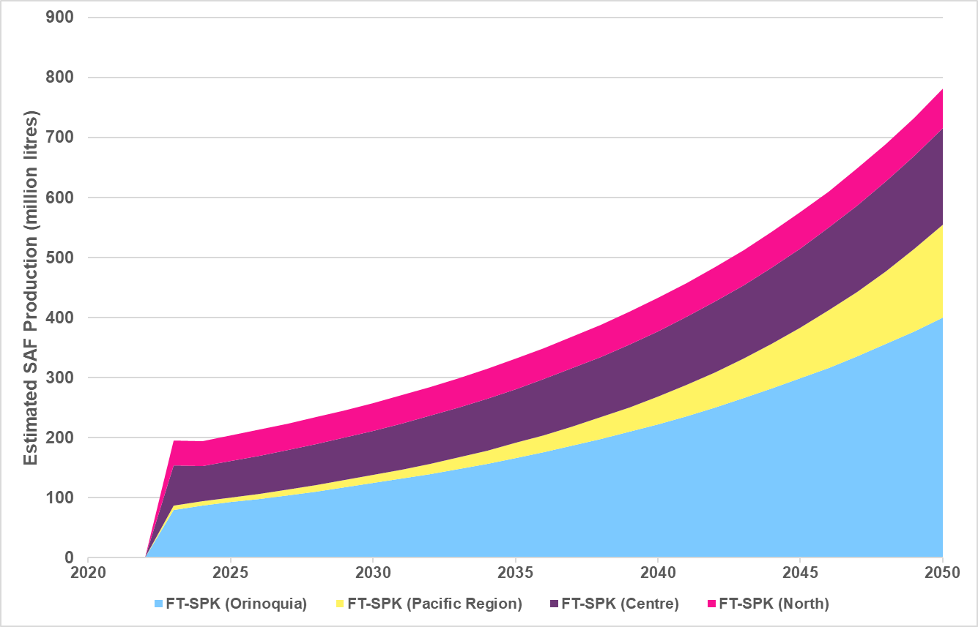
SAF PRODUCTION POTENTIAL FROM PALM
FT-SPK Production Potential (from palm residues)
Palm production does not necessarily have to increase in order for residues to be available for SAF production.
Residue availability is directly proportional to palm production.
Consequently, Orinoquia has the greatest potential for FT-SPK production.
Increase driven by expansion in land area only
Residues are available from all palm produced – not only palm for SAF

Slide 10
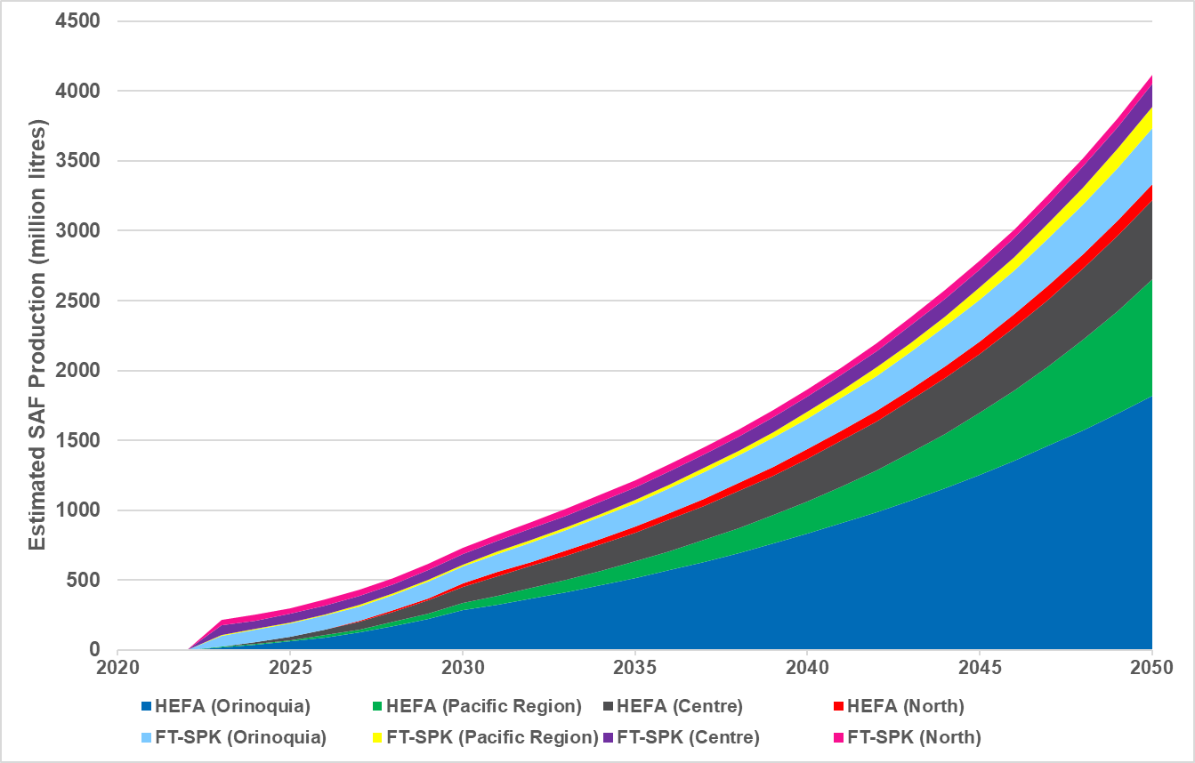
SAF PRODUCTION POTENTIAL FROM PALM
Total Production Potential from Oil and Residues
Overall, there is significant potential for SAF production from crude palm oil and palm residues.
Near-term, SAF potential from residues is greater than from CPO.
Mid/long-term, there is significant potential for SAF from CPO, provided:
  The area of land cultivated with palm expands.
  Methane is captured during CPO production

Slide 11
AGENDA
Assessing Colombian oil palm derivatives as a feasible SAF feedstock
Analysis of aviation fuel demand, SAF blending scenarios and emissions reductions
Proposed pathway for developing a SAF industry in Colombia and final recommendations

Slide 12
PROJECTION OF AVIATION FUEL DEMAND IN COLOMBIA
SAF adoption scenarios
Fuel consumption projection based on current demand for Jet A1, with demand growth projections for South America from ICAO and efficiency improvements from IATA ambition
Low, Mid and High SAF uptake scenarios based on fuel scenarios F1, F2, F3 from the ICAO Long Term Aspirational Goal (LTAG)
SAF uptake percentages from ICAO scenarios
Year | Low (F1) | Mid (F2) | High (F3)
2020 | 0% | 0% | 0%
2025 | 0% | 0% | 0%
2030 | 2.6% | 11.9% | 21.6%
2035 | 5.2% | 23.8% | 43.1%
2040 | 12.4% | 39.8% | 60.8%
2045 | 19.7% | 55.9% | 78.4%
2050 | 26.9% | 71.9% | 96.1%

Slide 13

PROJECTION OF AVIATION FUEL DEMAND IN COLOMBIA
Analysis of potential reduction from palm-based SAF

Slide 14
PROJECTION OF AVIATION FUEL DEMAND IN COLOMBIA
Main findings
Palm oil and derivatives in Colombia have the potential to cover the country's SAF demand under low, mid and high adoption scenarios.
For SAF produced from palm products in Colombia to be viable in the international market, CORSIA certification must be sought as a priority, meeting the minimum 10% emissions reduction compared to Jet A1.
To ensure eligibility of the SAF under CORSIA, it is essential to extend and intensify good practices such as methane capture, use of waste in the field and for heat recovery.
The Orinoquía region has the most potential to contribute to the production of SAF from oil palm derivatives in Colombia, surpassing the scenario of low adoption of SAF by far and approaching the mid scenario.

Slide 15
EMISSIONS MITIGATION POTENTIAL FROM THE USE OF SAF IN COLOMBIA
Initial considerations / Scenario assumptions
Life cycle assessment (LCA):
Three scenarios have been considered for GHG emissions reductions available from palm-based SAF. Key factors that influence GHG emissions, such as Palm Oil Mill Effluent (POME) treatment, waste utilization and ILUC factors have been quantified.
Well-to-wake (WTW) emissions analysis:
SAF has the same chemistry as Jet A1; therefore, the CO₂e emissions in the engine exhaust are the same. To capture the emissions reductions achievable from SAF requires the use of full lifecycle, or well-to-wake (WTW) emissions analyses.
WTW emissions factor for Jet A1: 89.0 gCO₂e/MJ (ICAO Reference value)
Scenario | WTW emissions | Comments
Optimum | 59.2 gCO₂e/MJ (-33%) | Closed pond POME treatment (85% methane recovery); Wastes (fibres, almond shells, other residual biomass) for heat recovery/energy production Lower end of ILUC range (34.6 gCO₂e/MJ); plantation established on non-productive agricultural land
Base | 74.5 gCO₂e/MJ (-16%) | Closed pond POME treatment (85% methane recovery); No wastes for heat recovery/energy production Mid value of ILUC range (39.1 gCO₂e/MJ); CORSIA recommendations
Worst | 118.6 gCO₂e/MJ (+33%) | Open pond POME treatment (no methane recovery); Upper value of ILUC range (60.2 gCO₂e/MJ)

Slide 16
EMISSIONS MITIGATION POTENTIAL FROM THE USE OF SAF IN COLOMBIA
Demand characterisation
Historic data indicate that aviation fuel consumption is split approximately 50% for domestic flights and 50% for international flights.
Fuel consumption projected to 2050 using separate demand growth projections from ICAO for domestic and international flights.

Slide 17
EMISSIONS MITIGATION POTENTIAL FROM THE USE OF SAF IN COLOMBIA
Emissions reductions depending on SAF production scenario
Optimum scenario
Base scenario
Worst scenario
Max reduction in WTW emissions | 2040 | 2050
Optimum scenario | 1.6 million tonnes CO₂e | 3.0 million tonnes CO₂e
Base scenario | 0.8 million tonnes CO₂e | 1.5 million tonnes CO₂e
Worst scenario | (1.6 million tonnes CO₂e increase) | (3.0 million tonnes CO₂e increase)

Slide 18
EMISSIONS MITIGATION POTENTIAL FROM SAF USE IN COLOMBIA
Main findings
To deliver the required reductions in emissions from palm oil-based SAF in Colombia, it will be necessary to employ actions and techniques for capturing methane and using wastes to enable Colombian palm oil to be considered an eligible raw material for SAF production under CORSIA.
Even using a mid-range value of ILUC for oil palm, by adopting good cultivation practices, SAF produced in Colombia from palm oil could achieve GHG emissions reductions greater than the minimum required by CORSIA of 10% relative to conventional Jet A1 fuel.
The Orinoquía has the potential to supply all SAF that will be required at Bogotá Airport under low, medium and high adoption scenarios. This, together with a “Book & Claim” mechanism, could present a great opportunity for both producers and consumers (airlines).
To consider exporting to Europe or other geographic areas, the specific environmental requirements of the region must be considered, which may be stricter than CORSIA (e.g., the European Union's Emissions Trading System (ETS) requires a minimum 60% reduction in emissions for SAF to have a zero emissions rating).
  Emissions reduction for palm-based SAF strongly dependent on ILUC value; need for assessment of Colombia-specific value to be determined (with international acceptance).

Slide 19
AGENDA
Assessing Colombian oil palm derivatives as a feasible SAF feedstock
Analysis of aviation fuel demand, SAF blending scenarios and emissions reductions
Proposed pathway for developing a SAF industry in Colombia and final recommendations

Slide 20












PROPOSED PATHWAY TO PROMOTE A SAF INDUSTRY IN COLOMBIA
SAF National
Roadmap
Governance and public policy strengthening
International cooperation and national programmes
R&D investment and infrastructure development
SAF Plant Construction
Promote SAF cost-effective measures
Oversee cometitiveness dynamics on the mid-term
2023
2026
2030
2040
Colombian Feedstock
Inventory
Feedstock Certification and Environmental measures to comply with certification criteria
(CORSIA y EU RED II)
Clear regulatory frameworks and positive market signals
(national “book & claim”)
Mandate: discuss and assess volume vs. emissions based
(Must be consulted with the demand and supply stakeholders)
Explore to develop SAF production projects through PPPs
Promote innovation and emissions reduction effectiveness in SAF

Slide 21






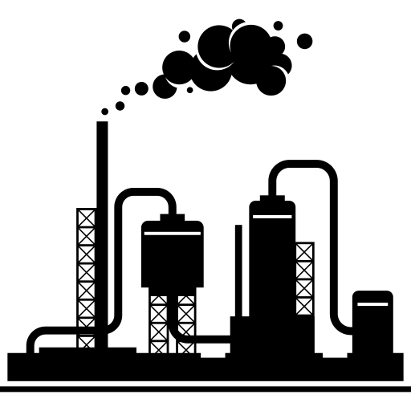

SAF Stakeholder Map in Colombia
Colombia
559,582 ha planted
7% increase rate in last 15 years
3.4 tonnes/ha of Crude Palm Oil (CPO) (2021)
Colombia
2 main refineries: Barrancabermeja and Cartagena
Typical operating capacity: 220,000 barrels per day (bpd) in Barrancabermeja and 200,000 bpd in Cartagena
At airport
Direct integration of SAF into the existing fuel infrastructure on-site
SAF could be transported directly to airports by trucks
The ground transportation distances could vary between 120 km and 570 km, to the airports of Bogota and Cali, respectively (from Villavicencio, where possibly could be located a SAF plant)
Colombia
The national fuel demand is concentrated in 4 main airports, 60% in Bogota, 15% in Medellin; 8% in Palmira (Cali), 7% in Cartagena and 10% in others
Petroleum refineries
Airports
Airlines
Palm oil producers
Palm oil mills
SAF blending
Fuel distributors
Colombia
In 2022, 32.7 million of passengers were transported on domestic flights, while 15.2 million were on international flights
The top airlines in terms of operations are Avianca, Latam Airlines, Wingo and EasyFly
Avianca holds the largest market share with over 32%, followed by Latam airlines with 17.55%, Viva, which closed operations, accounted for 15%, Wingo a 4.33% and Ultra holds a 3% share of the Colombian market
SAF plants
Orinoquía
278,512 ha planted
5.7-7.4% increase rate in last 5 years
3.58 tonnes/ha of CPO (average)
Orinoquía
Total capacity of 780 tons FFB/hour
There are 31 Palm Oil (PO) mills
At refinery
Involves incorporating SAF during the refining process
Considering logistics of refineries of Ecopetrol, SAF production would need to be blended there and transported through fuel pipelines
Colombia
Terpel is the main player in jet fuel distribution with about 60% of the market
Usually, the distributors own the facilities at the airport
Around 100 jet fuel service stations in the country: Terpel (24), Energizar (19), Icaro (15).
Colombia
There are no SAF plants in Colombia
It takes 2-4 years to construct a new SAF plant (Greenfield)
Notes:
Create a SAF National Roadmap
Create feedstocks inventory
Tasks suggested by ICAO are: quantify available feedstocks, identify potential feedstock crops, identify suitable land available (considering restrictions in land use) and classify the areas in terms of infrastructure and estimated production cost

Slide 22
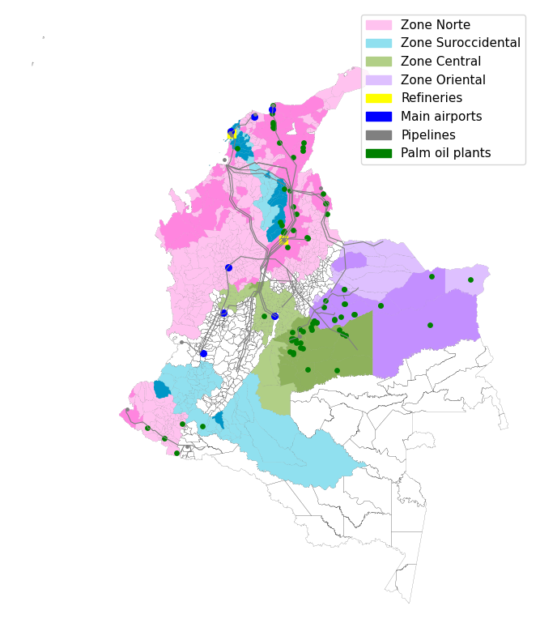
Colombian SAF value chain map
Notes:
For the certification of SAF in Colombia, the Colombian Government and SAF supply chain stakeholders could undertake the following steps:
Adopting the ASTM 7566 standard by the National Government. It can be adopted by modifying Resolucion 40263 of 2022.
Concluding the process of enacting the national standard for aviation turbine fuel containing synthesised hydrocarbons.
Certification of national laboratories in order to conduct physicochemical tests and verify the SAF compliance according to the the ASTM 7566 standard.
Standard Specification for Aviation Turbine Fuel Containing Synthesised Hydrocarbons.
ICONTEC has already started this process and a project of the national standard (NTC 6546) has been published for public discussion.
Create feedstocks inventory
Tasks suggested by ICAO are: quantify available feedstocks, identify potential feedstock crops, identify suitable land available (considering restrictions in land use) and classify the areas in terms of infrastructure and estimated production cost

